Slide 1

DEMAND INTELLIGENCE
Caerwen University
Ten-year UCAS undergraduate funnel analysis with peer benchmarking
D1 | April 2026 | UCAS End of Cycle 2025 | Prepared by Blairgowrie HE Advisory
Illustrative Report with Live Data
Data vintage: UCAS End of Cycle 2025 (released December 2025). Valid 12 months.

Slide 2

Validity & Data Sources
VALIDITY
DATA SOURCES
12-month window from data vintage
This report uses UCAS End of Cycle 2025 data (released December 2025).
Valid until: December 2026
UCAS releases End of Cycle data annually in December. Interim deadline-day releases (January, March, June) provide partial-cycle visibility but are not used as primary sources here.
UCAS End of Cycle (provider funnel)
Applicants, applications, offers, accepted by domicile
Sector coverage: 460 UK HE providers
Provider directory cross-link
UCAS code ↔ UKPRN resolution
Resolved: Caerwen University (UCAS B06, UKPRN 10007857)
METHODOLOGY
Doctoral-grade funnel analysis with explicit yield decomposition.
Ten-year applicant, offer, and acceptance trajectory. Yield (acceptances / offers) decomposed by domicile and UK region. Offer rate, OTA share, and conversion ratios tracked over the full window. Subject mix uses HESA Table 51 qualifiers as an indicative proxy (graduation completions, ~3 year lag) — not used in funnel analysis. Peer comparison against confirmed institutions only.
Authored by Dr David O'Connor, DBA (University of Bath, 2023). 14 years of UK HE leadership including PVC at BIMM University. Two private-equity exits at 4x returns. 300%+ enrolment growth across the operating track record.
Illustrative Report with Live Data
blairgowriehe.com | david@blairgowriehe.com | Confidential

Slide 3
Executive Summary
ACCEPTED 2025
YIELD 2025
INTERNATIONAL UCAS
1,955
23.8%
75
-27.1% over 10 years
Peak 32.7% (2020)
3.8% of intake
Trajectory: sustained decline
-8.9pp from peak
Yield 6.3% — effectively dead
HEADLINE FINDING
Demand pressure on every dimension of the funnel.
Caerwen's UCAS undergraduate intake has fallen -27.1% over a decade, from 2,680 accepted in 2016 to 1,955 in 2025. The institution's peak yield year was 2020 at 32.7%; yield is now 23.8%, a -8.9pp collapse over five years. The offer rate has dropped from 86.1% to 75.1% — Caerwen is making fewer offers per applicant. International UCAS undergraduate is functionally extinct: 75 accepted students (3.8% of intake), with international yield at 6.3% versus UK yield 26.7%. The Welsh-domiciled share of UK acceptances has also weakened, falling from a 49.5% peak (2020) to 42.6% in 2025. This dataset cross-references with D2 (enrolment), D4 (financial health) and D5 (NSS): the NSS turnaround has not yet flowed through to UCAS yield, and the financial pressure documented in D4 is the direct downstream consequence of the demand erosion documented here.
Illustrative Report with Live Data
blairgowriehe.com | david@blairgowriehe.com | Confidential

Slide 4
01
The Funnel & The Yield
Ten-year movement across applicants, offers, acceptances, and conversion.
Illustrative Report with Live Data

Slide 5
Ten-Year UCAS Funnel
Year | Applicants | Offers | Accepted | Offer rate | Yield
2016 | 9,875 | 9,380 | 2,680 | 86.1% | 27.1%
2017 | 8,665 | 8,475 | 2,465 | 88.7% | 28.4%
2018 | 7,805 | 7,655 | 2,390 | 87.6% | 30.6%
2019 | 6,890 | 6,635 | 2,200 | 85.4% | 31.9%
2020 | 6,705 | 6,565 | 2,195 | 85.6% | 32.7%
2021 | 8,275 | 7,935 | 2,290 | 84.7% | 27.7%
2022 | 8,425 | 7,860 | 2,200 | 81.9% | 26.1%
2023 | 7,720 | 7,175 | 2,160 | 81.8% | 28.0%
2024 | 8,365 | 7,335 | 2,025 | 77.8% | 24.2%
2025 | 8,215 | 6,975 | 1,955 | 75.1% | 23.8%
Acceptances peaked at 2,680 in 2016 and have declined nearly every year since. Yield peaked at 32.7% in 2020; the post-2020 collapse is the most diagnostic single signal in the dataset.
Illustrative Report with Live Data
blairgowriehe.com | david@blairgowriehe.com | Confidential

Slide 6
Yield Decomposition
THE YIELD STORY
WHAT THE YIELD COLLAPSE MEANS
23.8%
Caerwen is making more offers but converting fewer of them.
2025 yield (acceptances ÷ offers)
In 2020 Caerwen made 6,565 offers and converted 2,195 (yield 32.7%). In 2025 Caerwen made 6,975 offers and converted only 1,955 (yield 23.8%). Offer volume has held roughly constant; conversion has collapsed.
WHAT DRIVES YIELD
Yield is the moment the prospective student decides whether Caerwen is the place. The decision happens after the offer, after open days, after the comparison with other offers, after the financial calculation, and after the brand impression formed by NSS scores, graduate destinations, and review platforms.
THE D5 PARADOX
D5 NSS Intelligence shows Caerwen delivered a sector-leading turnaround on Organisation and Student Voice in 2024-25. That turnaround has not yet flowed through to yield. The two windows do not overlap: students choosing in 2025 were comparing Caerwen against the pre-improvement reputation, not the post-improvement one. Yield recovery should follow within 12-18 months — provided the new NSS scores reach prospective student attention.
FIVE-YEAR YIELD MOVEMENT
2020: 32.7% (2,195 accepted)
2021: 27.7% (2,290 accepted)
2022: 26.1% (2,200 accepted)
2023: 28.0% (2,160 accepted)
2024: 24.2% (2,025 accepted)
2025: 23.8% (1,955 accepted)
-8.9pp
peak-to-current
yield collapse
Illustrative Report with Live Data
blairgowriehe.com | david@blairgowriehe.com | Confidential

Slide 7
Offer Rate — The Other Lever
Year | Applicants | Offers | Offer rate | YoY change (pp)
2016 | 9,875 | 9,380 | 86.1% | —
2017 | 8,665 | 8,475 | 88.7% | +2.6pp
2018 | 7,805 | 7,655 | 87.6% | -1.1pp
2019 | 6,890 | 6,635 | 85.4% | -2.2pp
2020 | 6,705 | 6,565 | 85.6% | +0.2pp
2021 | 8,275 | 7,935 | 84.7% | -0.9pp
2022 | 8,425 | 7,860 | 81.9% | -2.8pp
2023 | 7,720 | 7,175 | 81.8% | -0.1pp
2024 | 8,365 | 7,335 | 77.8% | -4.0pp
2025 | 8,215 | 6,975 | 75.1% | -2.7pp
Offer rate has fallen -11.0pp over the decade and -9.6pp since 2021. Caerwen is making fewer offers per applicant, suggesting tightened entry criteria or capacity management — neither of which compounds well with a yield collapse.
Illustrative Report with Live Data
blairgowriehe.com | david@blairgowriehe.com | Confidential

Slide 8
02
Domicile & Catchment
Where applicants come from. Where the supply has weakened.
Illustrative Report with Live Data

Slide 9
Domicile Trajectory — Ten-Year View
Year | UK | EU | Non-EU | Intl total | Intl % | Intl yield
2016 | 2,430 | 140 | 105 | 245 | 9.1% | 18.9%
2017 | 2,215 | 145 | 100 | 250 | 10.1% | 21.5%
2018 | 2,170 | 125 | 95 | 220 | 9.2% | 22.3%
2019 | 2,000 | 105 | 100 | 205 | 9.3% | 22.3%
2020 | 1,980 | 145 | 70 | 215 | 9.8% | 21.7%
2021 | 2,165 | 60 | 65 | 125 | 5.5% | 15.0%
2022 | 2,075 | 40 | 85 | 125 | 5.7% | 14.0%
2023 | 2,050 | 40 | 70 | 110 | 5.1% | 12.4%
2024 | 1,915 | 20 | 90 | 110 | 5.4% | 8.6%
2025 | 1,880 | 15 | 60 | 75 | 3.8% | 6.3%
EU collapsed from 140-145 students per year (pre-Brexit) to 15 in 2025. Non-EU drifted from 105 to 60. Crucially, international yield has dropped from 22% in 2018-19 to 6.3% in 2025: the funnel front-end has weakened, and conversion has collapsed even more sharply.
Illustrative Report with Live Data
blairgowriehe.com | david@blairgowriehe.com | Confidential

Slide 10
UK Regional Catchment — The Welsh Home Market
THE NUMBERS
LOSING THE HOME MARKET
42.6%
A Welsh research university losing share in Wales.
Wales share of UK accepted (2025)
Caerwen recruited 980 Welsh-domiciled students in 2020 (49.5% of UK intake) and only 800 in 2025 (42.6%). The home market share has fallen by nearly 7 percentage points in five years. The English-domiciled column is now larger than the Welsh one, by a meaningful margin.
WHY THIS MATTERS
Welsh-domiciled students are the most strategically valuable cohort for a Welsh university: lower acquisition cost, higher yield, deeper community linkage, and a structural alignment with HEFCW funding incentives. Losing share in the home market is more concerning than losing share in any other market — it suggests the institution is being out-recruited by Cardiff and Swansea inside its own catchment.
CROSS-REFERENCE
D2 enrolment data shows Welsh undergraduate UCAS pipeline weakening as part of a broader UK acquisition story. Stabilising the Welsh share is the highest-leverage marketing intervention available — it is also the lowest-cost.
Down from 49.5% peak in 2020
UK REGIONAL ACCEPTANCES 2025
England: 1,055 (56.1%)
Wales: 800 (42.6%)
Scotland: 5 (0.3%)
Northern Ireland: 20 (1.1%)
-180
Welsh acceptances
lost from 2020 peak
Illustrative Report with Live Data
blairgowriehe.com | david@blairgowriehe.com | Confidential

Slide 11
International UCAS — A Channel That Has Closed
THE COLLAPSE
TWO TIMELINES, ONE STORY
6.3%
Undergraduate UCAS international has been collapsing since Brexit.
International yield 2025
EU UCAS undergraduate has fallen ~90% since 2020 — a clean post-Brexit collapse driven by tuition fee changes and visa friction. Non-EU undergraduate has drifted down too, but the bigger story for non-EU is the yield. International applicants are still applying (the front-end of the funnel is intact at 75 acceptances) but the conversion rate has dropped from 22% to 6%.
THE D2 LINKAGE
D2 Enrolment Intelligence shows non-EU enrolment fell from 2,715 (2022/23 peak) to 1,930 in 2024/25 — but D2 is an HESA all-levels measure dominated by international taught-postgraduate. The D1 international UCAS undergraduate channel is much smaller (75 students) and has been weak for longer. There are two parallel collapses: a slow undergraduate decline over a decade, and a rapid taught-PG contraction in a single year.
COMMERCIAL READ
Reviving international UCAS undergraduate is a 3-5 year project requiring agent network investment and visa-friendly programme design. It is not a quick win but it is the only way to rebuild a balanced intake.
Down from 22.3% in 2018
YIELD COLLAPSE BY DOMICILE
2018: Intl 22.3% | UK 31.8%
2020: Intl 21.7% | UK 34.6%
2022: Intl 14.0% | UK 27.6%
2024: Intl 8.6% | UK 27.0%
2025: Intl 6.3% | UK 26.7%
15
EU students accepted
in 2025 (was 145 in 2020)
Illustrative Report with Live Data
blairgowriehe.com | david@blairgowriehe.com | Confidential

Slide 12
03
Peer Comparison
Welsh and research-intensive comparators, confirmed not inferred.
Illustrative Report with Live Data

Slide 13
Peer Comparison — UCAS Funnel 2025
Institution | Applicants | Offers | Accepted | Offer rate | Yield
Caerwen University | 8,215 | 6,975 | 1,955 | 75.1% | 23.8%
Aberystwyth University | 8,400 | 7,740 | 1,675 | 85.6% | 19.9%
Swansea University | 17,960 | 14,325 | 4,695 | 74.0% | 26.1%
Cardiff University | 43,480 | 33,135 | 7,405 | 72.4% | 17.0%
University of Hull | 9,345 | 8,120 | 2,730 | 76.5% | 29.2%
Keele University | 16,285 | 11,795 | 2,955 | 68.3% | 18.1%
PEER READ
On 2025 yield, Caerwen ranks 3 of 6 in the peer group. Cardiff and Swansea sit highest — both are larger institutions in major urban catchments. Caerwen's offer rate at 75.1% is the lowest in the peer group, and the yield collapse documented in section 01 is more pronounced than at any peer except possibly Hull. Aberystwyth has a lower yield (19.9%) but a less severe peak-to-trough decline. The Caerwen pattern of high offer volume converting to falling acceptances is unique within this peer set.
Illustrative Report with Live Data
blairgowriehe.com | david@blairgowriehe.com | Confidential

Slide 14
Peer Comparison — Five-Year Yield Trajectory
Institution | 2021 | 2022 | 2023 | 2024 | 2025
Caerwen University | 27.7% | 26.1% | 28.0% | 24.2% | 23.8%
Aberystwyth University | 21.4% | 23.6% | 23.3% | 21.5% | 19.9%
Swansea University | 27.6% | 29.1% | 28.2% | 27.7% | 26.1%
Cardiff University | 18.9% | 16.7% | 17.8% | 18.2% | 17.0%
University of Hull | 31.6% | 32.2% | 32.9% | 27.6% | 29.2%
Keele University | 18.0% | 17.8% | 18.7% | 17.6% | 18.1%
TRAJECTORY READ
Note that this report omits the OfS clearing dependency by tariff band callout — Caerwen is a Welsh provider and is outside the OfS regulatory perimeter (HEFCW jurisdiction). The clearing tariff band lookup returns "Not found" by design, and this slide therefore presents peer yield trajectory only. Across the peer group, every institution shows a yield decline since 2021, but Caerwen's decline (32.7% in 2020 to 23.8% in 2025, -8.9pp peak-to-current) is the steepest in the group.
Illustrative Report with Live Data
blairgowriehe.com | david@blairgowriehe.com | Confidential

Slide 15
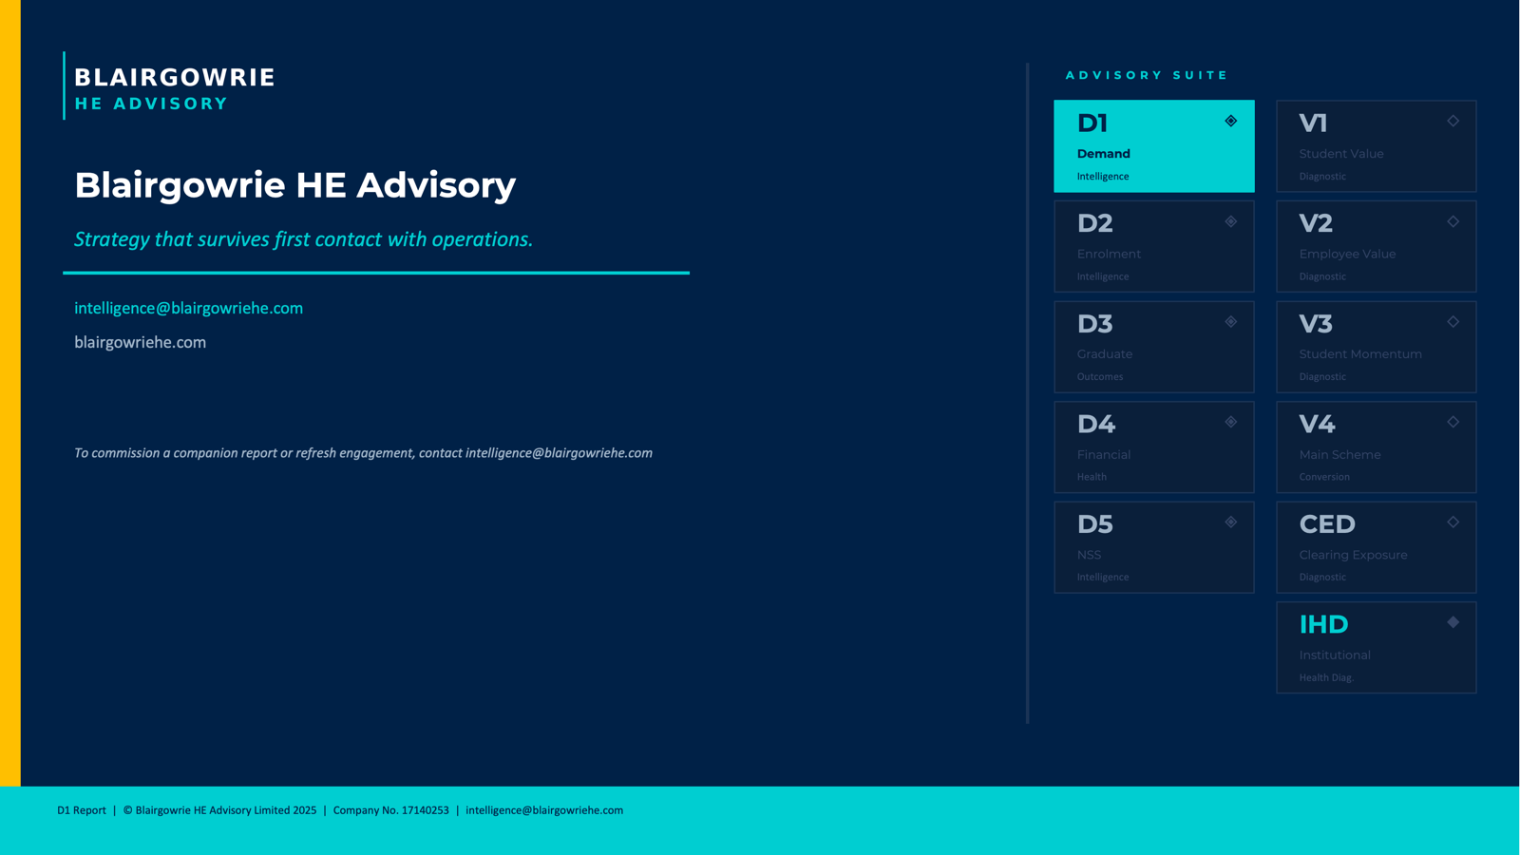
The Blairgowrie Take
HEADLINE FINDING
WHERE THE PRESSURE COMES FROM
UCAS undergraduate intake has fallen -27.1% over a decade. Yield peaked at 32.7% in 2020 and has collapsed to 23.8% in 2025 — a 9pp drop in five years. Offer rate has fallen from 86% to 75% over the same window. The processor classifies trajectory as "sustained decline" and that is correct on every dimension of the funnel.
Three parallel collapses. (1) International EU: ~90% gone since Brexit, now 15 students. (2) International non-EU: yield collapsed from 22% to 6%. (3) Welsh home market share: down from 49.5% (2020) to 42.6% — losing share inside the home catchment to Cardiff and Swansea. Each is independently serious; together they compound.
THE D5 PARADOX
STRATEGIC PRIORITIES
D5 NSS Intelligence shows Caerwen delivered a sector-leading turnaround on Organisation (+14.5pp) and Student Voice (+10.9pp). That improvement has not yet flowed through to UCAS yield because the cohorts choosing in 2024-25 were comparing against pre-improvement reputation. Yield recovery should follow within 12-18 months — but only if the new NSS scores reach prospective student attention through Discover Uni and review platforms.
1) Stabilise the Welsh home market — highest leverage, lowest cost, deepest strategic value. 2) Treat 2026 cycle as the binary test of whether NSS recovery flows through to yield. 3) Material international UCAS recovery is a 3-5 year project requiring agent investment. 4) Cross-reference D2 enrolment and D4 financial position before any decision on tightening offer criteria — the offer rate has already fallen 11pp.
Authored by Dr David O'Connor, DBA. UCAS End of Cycle data is regulated census information at provider level. Ten-year window. Peer comparison against confirmed institutions only. OfS clearing tariff dependency callout omitted — Welsh provider outside OfS perimeter.
Illustrative Report with Live Data
blairgowriehe.com | david@blairgowriehe.com | Confidential

